Slide 1
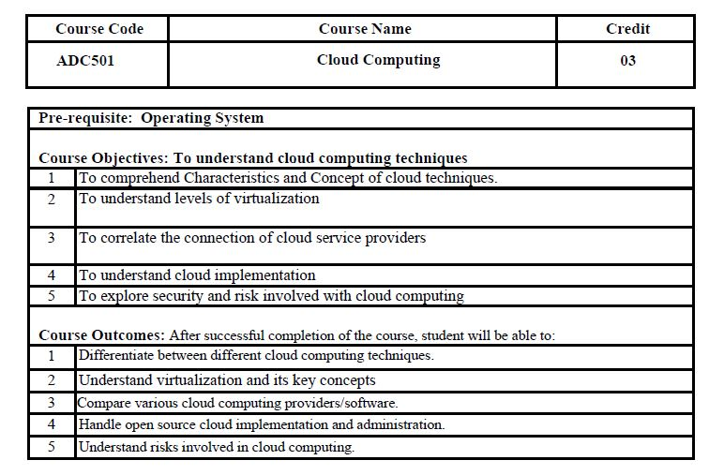

Slide 2
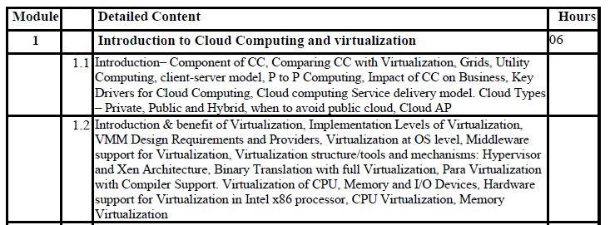
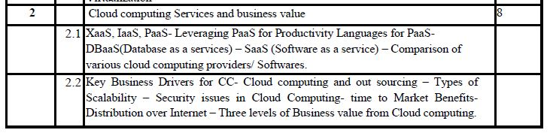

Slide 3
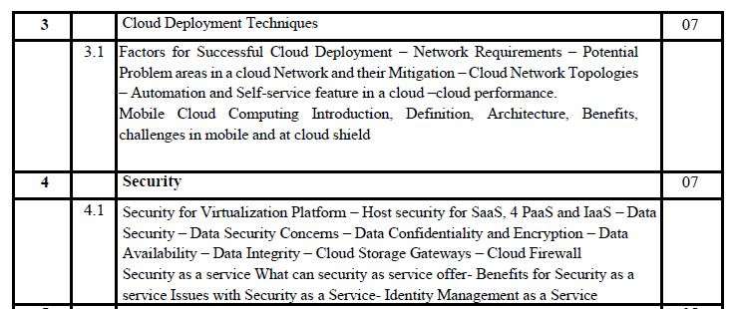
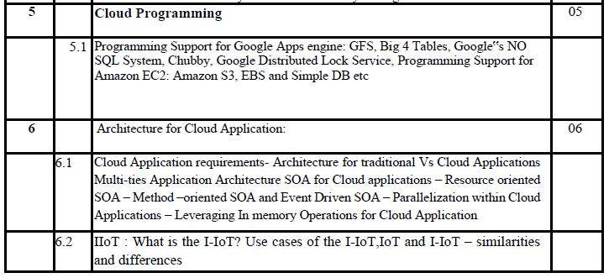

Slide 4
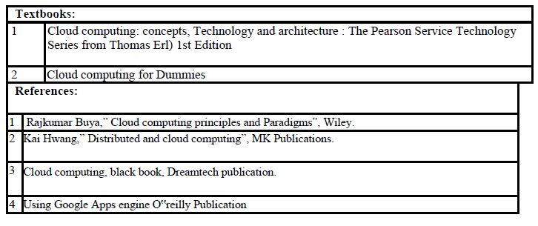

Slide 5
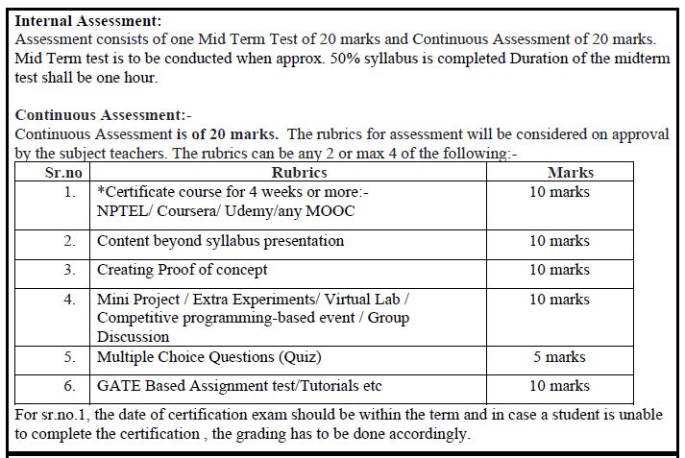

Slide 6
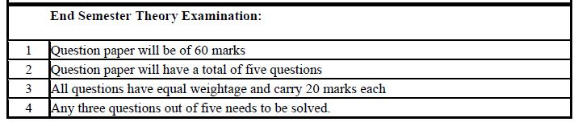

Slide 7
Module No. | Module Name | Hours | Marks
1 | Introduction to Cloud Computing and virtualization | 6 | 15
2 | Cloud computing Services and business value | 8 | 21
3 | Cloud Deployment Techniques | 7 | 18
4 | Security | 7 | 18
5 | Cloud Programming | 5 | 13
6 | Architecture for Cloud Application | 6 | 15
Total Hours and Marks |  | 39 | 100

Slide 8
Module 1 Introduction to Cloud Computing and virtualization
Subject: Cloud computing
Mr. AJINKYA VALANJOO

Slide 9
Overview
Introduction to Cloud Computing
Cloud characteristics
Cloud computing components
Comparing of cloud computing with Peer to peer architecture, Client server, Distributed, Grid
Cloud Deployment Model – Public, Private, Community, Hybrid
Service Models – SaaS, PaaS, IaaS

Slide 10
What is Computing?
Includes designing and building hardware / software for a wide range of purposes, processing, structuring and managing various kinds of information
Distributed Computing
Grid Computing
Cluster Computing
Utility Computing
Cloud Computing

Slide 11
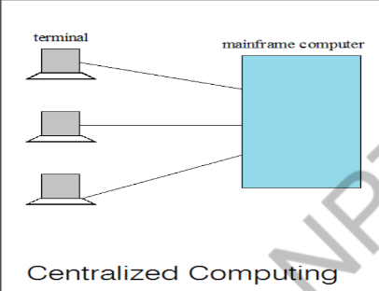
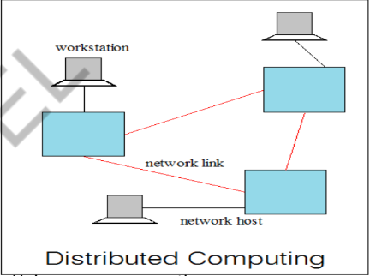
Centralized Vs Distributed Computing

Slide 12
Distributed computing
Controlling and managing is distributed
Uni processor is not a concept
Distributed Processor carries its own local memory and storage
It provides computing services in distributed manner
Each processor communicates with another processor through high speed lines
Components: Workstations, Servers, Personal assistant devices
Examples: Internet, ATM machines, Intranet

Slide 13
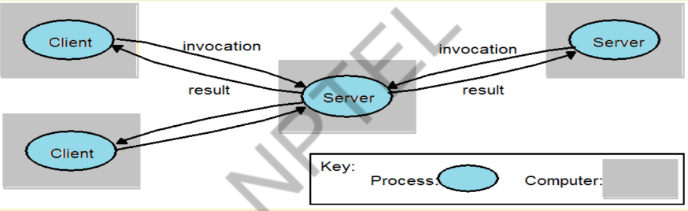
Distributed applications
1. Clients invoke individual servers

Slide 14
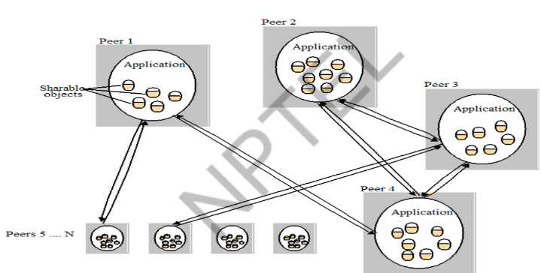
2. A typical distributed application based on peer processes

Slide 15
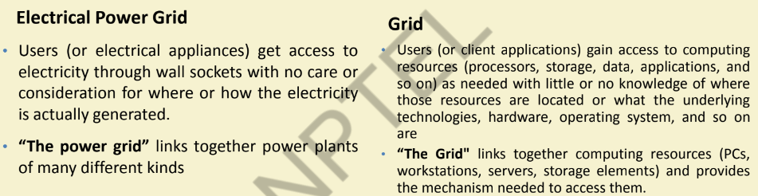
Grid Computing
Grid computing harnesses unused processing cycles of all computers in a network for solving problems too intensive for any stand-alone machine

Slide 16
Application of Grid computing
Today’s Science/Research is based on computations, data analysis, data visualization & collaborations
Computer Simulations & Modelling are more cost effective than experimental methods
Scientific and Engineering problems are becoming more complex & users need more accurate, precise solutions to their problems in shortest possible time
Data Visualization is becoming very important
Exploiting under utilized resources

Slide 17
Cluster Computing
A cluster is a type of parallel or distributed computer system, which consists of a collection of inter-connected stand-alone computers working together as a single integrated computing resource
Key components of a cluster include multiple standalone computers (PCs, Workstations, or SMPs), operating systems, high-performance interconnects, middleware, parallel programming environments, and applications.
Clusters are usually deployed to improve speed and/or reliability over that provided by a single computer
Basic building blocks of clusters are broken down into multiple categories:
• Cluster Nodes
• Cluster Network
• Network Characterization

Slide 18
Utility Computing
Utility Computing is purely a concept which cloud computing practically implements
Utility computing is a service provisioning model in which a service provider makes computing resources and infrastructure management available to the customer as needed, and charges them for specific usage rather than a flat rate.
Some highlights:
a) Pay-for-use Pricing Business Model
b) Data Center Virtualization and Provisioning
c) Solves Resource Utilization Problem
d) Outsourcing
e) Web Services Delivery
f) Automation
Drawbacks: Data Backup , Data Security, Partner Competency, Defining SLA

Slide 19
Cloud Computing
NITS (National Institute of Standards and Technology ) defines Cloud Computing as;
“ Cloud computing is a model for enabling ubiquitous, convenient, on-demand network access to a shared pool of configurable computing resources (e.g networks, servers, storage, applications, and services) that can be rapidly provisioned and released with minimal management effort or service provider interaction. ”

Slide 20
Characteristics
On-demand self-service:
A consumer can unilaterally provision computing capabilities, such as server time and network storage, as needed automatically without requiring human interaction with each service provider
Broad network access:
Capabilities are available over the network and accessed through standard mechanisms that promote use by heterogeneous thin or thick client platforms (e.g., mobile phones, tablets, laptops, and workstations).
Resource pooling
The provider’s computing resources are pooled to serve multiple consumers using a multi-tenant model, with different physical and virtual resources dynamically assigned and reassigned according to consumer demand

Slide 21
Continue..
Rapid elasticity:
- Capabilities can be rapidly and elastically provisioned - in some cases automatically - to quickly scale out; and rapidly released to quickly scale in.
To the consumer, the capabilities available for provisioning often appear to be unlimited and can be purchased in any quantity at any time
Measured service:
Cloud systems automatically control and optimize resource usage by leveraging a metering capability at some level of abstraction appropriate to the type of service
Resource usage can be monitored, controlled, and reported - providing transparency for both the provider and consumer of the service

Slide 22
Some other common characteristics
Massive scale
Resilient computing
Homogeneity
Geographic distribution
Virtualization
Service orientation
Low cost software
Advanced security

Slide 23
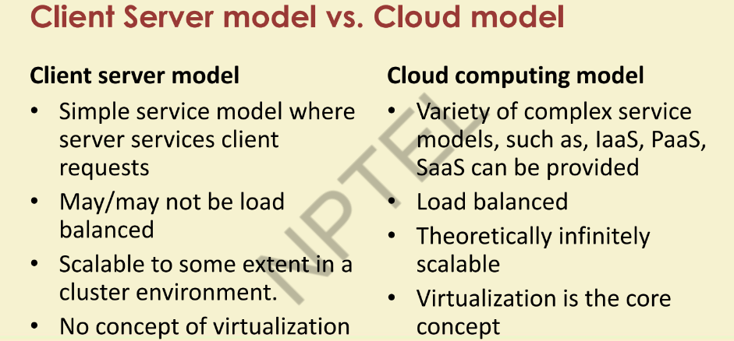

Slide 24
Cloud Deployment Models
Public Cloud
Private Cloud
Community Cloud
Hybrid Cloud

Slide 25
Public Cloud
The cloud infrastructure is made available to the general public or a large industry group and is owned by an organization selling cloud services.
E.g. Microsoft Azure, AWS, Google clouds etc.

Slide 26
Private Cloud
The cloud infrastructure is operated solely for a single organization. It may be managed by the organization or a third party, and may exist on-premises or off-premises.
It has high level of security and privacy.
E.g. HP data centers

Slide 27
Community Cloud
The cloud infrastructure is made available to multiple organizations where they share resources and services based on common operational and regulatory requirements.
E.g. IBM SoftLayer cloud

Slide 28
Hybrid Cloud
The cloud infrastructure is a composition of two or more clouds (private, community, or public) that remain unique entities but are bound together by standardized or proprietary technology that enables data and application portability (e.g., cloud bursting for load-balancing between clouds)

Slide 29
Cloud Service Models
1. Cloud Software as a Service (SaaS)
2. Cloud Platform as a Service (PaaS)
3. Cloud Infrastructure as a Service (IaaS)

Slide 30
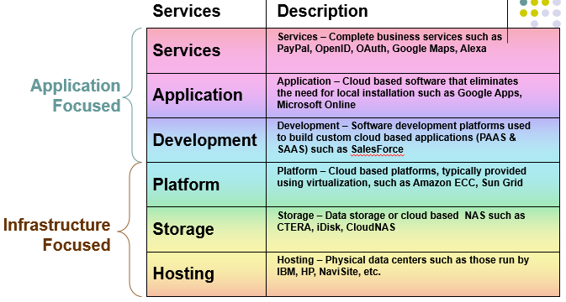

Slide 31
Software as a Service (SaaS)
The capability provided to the consumer is to use the provider’s applications running on a cloud infrastructure.
The applications are accessible from various client devices through a thin client interface such as a web browser (e.g., web-based email).
The consumer does not manage or control the underlying cloud infrastructure including network, servers, operating systems, storage, or even individual application capabilities, with the possible exception of limited user-specific application configuration settings.

Slide 32
Platform as a Service (PaaS)
The capability provided to the consumer is to deploy onto the cloud infrastructure consumer created or acquired applications created using programming languages and tools supported by the provider
The consumer does not manage or control the underlying cloud infrastructure including network, servers, operating systems, or storage, but has control over the deployed applications and possibly application hosting environment configurations

Slide 33
Infrastructure as a Service (IaaS)
The capability provided to the consumer is to provision processing, storage, networks, and other fundamental computing resources.
Consumer is able to deploy and run arbitrary software, which can include operating systems and applications
The consumer does not manage or control the underlying cloud infrastructure but has control over operating systems, storage, deployed applications, and possibly limited control of select networking components (e.g., host firewalls)

Slide 34
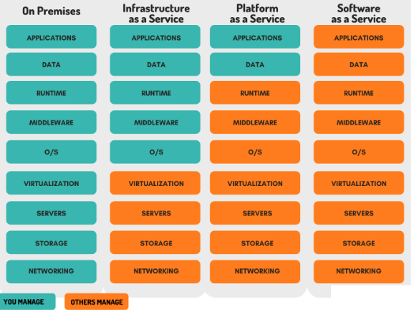

Slide 35
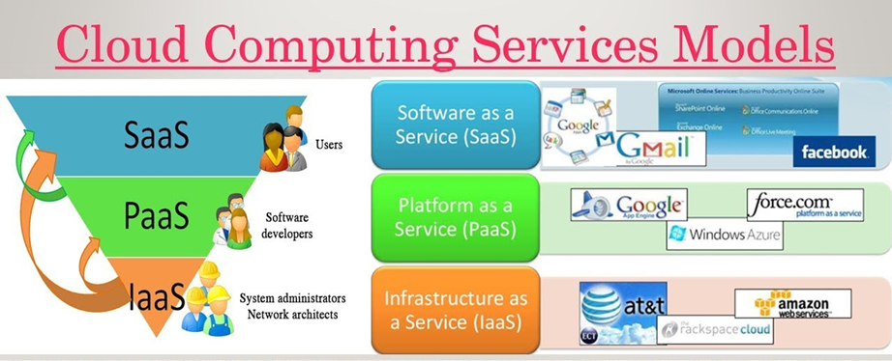

Slide 36
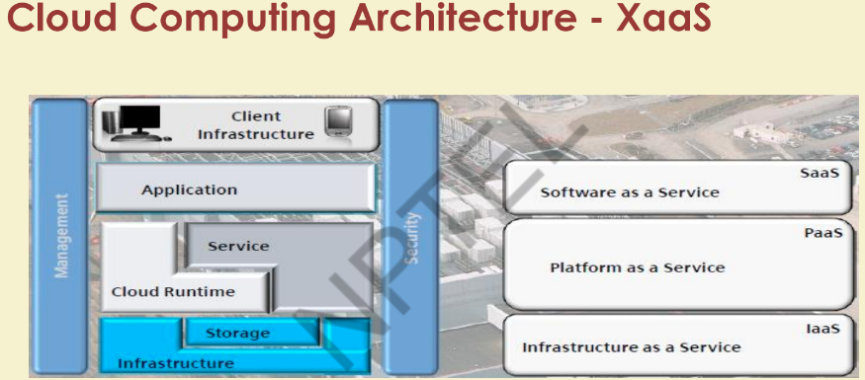

Slide 37
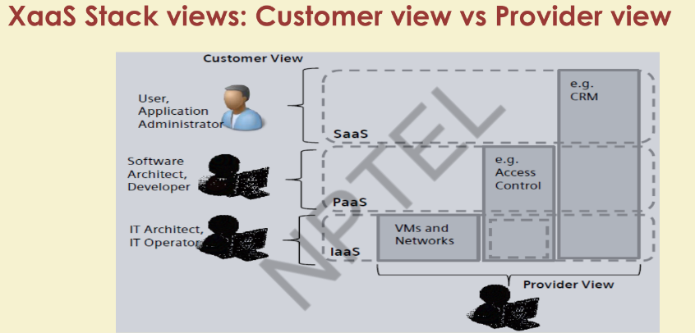

Slide 38
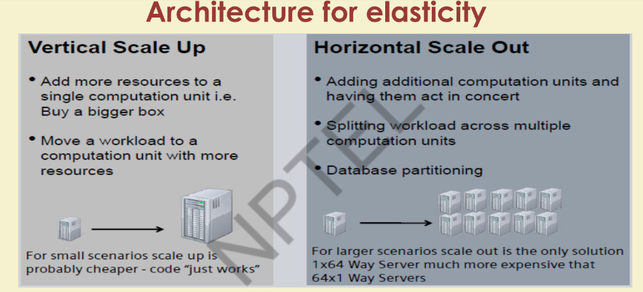

Slide 39
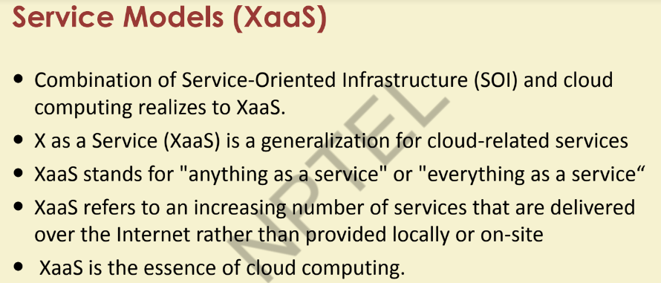

Slide 40
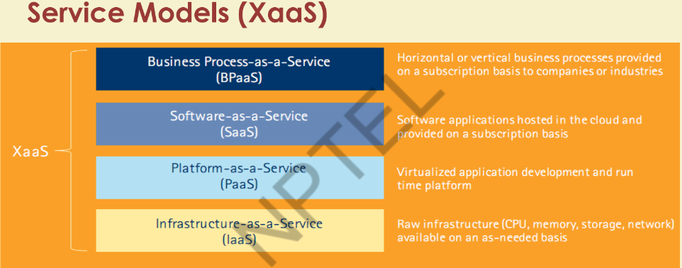

Slide 41
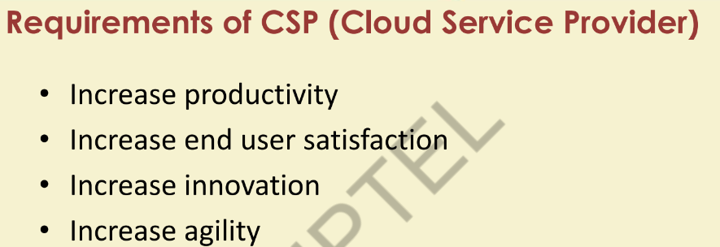

Slide 42
Advantages
Lower Computer cost
Improved software updates
Improved document format capabilities
Unlimited storage capacity
Increased data reliability
Universal information access
Latest version availability
Easier group collaboration
Device independance

Slide 43
Drawback
Requires constant internet connection
Does not work well with low speed
Features might be limited
Can be slow
Security
Stored data can be lost

Slide 44
Thank You!

